Slide 1
7 Algorithm design and problem-solving
Bubble sort

Slide 2



Bubble sort
Sorts an unordered list of items.
Compares each item with the next and swaps them if they are out of order – in effect, bubbling the largest (or smallest) item up to the end of the list.
Finishes when no more swaps need to be made.
The most inefficient of the sorting algorithms but very easy to implement.
A popular choice for very small data sets.
Bubble sort is covered in detail with fully coded examples from page 154 of our book – more information at the end of this video.

Slide 3
Bubble sort
4
3
2
1
0
Cornflakes
Fruit ‘n’ Fibre
Weetabix
Crunchy Nut Clusters
Sugar Puffs
Weetabix
Sugar Puffs
Fruit ‘n’ Fibre
Crunchy Nut Clusters
Cornflakes
4
3
2
1
0

Slide 4
Bubble sort
4
3
2
1
0
Cornflakes
Fruit ‘n’ Fibre
Weetabix
Crunchy Nut Clusters
Sugar Puffs
4
3
2
1
0
Compare the first two items.
Are they in the right order?

Slide 5
Bubble sort
4
3
2
1
0
Cornflakes
Fruit ‘n’ Fibre
Weetabix
Crunchy Nut Clusters
Sugar Puffs
Cornflakes
Fruit ‘n’ Fibre
Weetabix
Sugar Puffs
Crunchy Nut Clusters
4
3
2
1
0
They are not, so swap them over.

Slide 6
Bubble sort
4
3
2
1
0
Cornflakes
Fruit ‘n’ Fibre
Weetabix
Crunchy Nut Clusters
Sugar Puffs
Cornflakes
Fruit ‘n’ Fibre
Weetabix
Sugar Puffs
Crunchy Nut Clusters
4
3
2
1
0
Compare the next two items.
Are they in the right order?

Slide 7
Bubble sort
4
3
2
1
0
Cornflakes
Fruit ‘n’ Fibre
Weetabix
Crunchy Nut Clusters
Sugar Puffs
Cornflakes
Fruit ‘n’ Fibre
Weetabix
Sugar Puffs
Crunchy Nut Clusters
Cornflakes
Fruit ‘n’ Fibre
Weetabix
Sugar Puffs
Crunchy Nut Clusters
4
3
2
1
0
They are in the right order,
so leave them where they are.

Slide 8
Bubble sort
4
3
2
1
0
Cornflakes
Fruit ‘n’ Fibre
Weetabix
Crunchy Nut Clusters
Sugar Puffs
Cornflakes
Fruit ‘n’ Fibre
Weetabix
Sugar Puffs
Crunchy Nut Clusters
Cornflakes
Fruit ‘n’ Fibre
Weetabix
Sugar Puffs
Crunchy Nut Clusters
4
3
2
1
0
Compare the next two items.
Are they in the right order?

Slide 9
Bubble sort
4
3
2
1
0
Cornflakes
Fruit ‘n’ Fibre
Weetabix
Crunchy Nut Clusters
Sugar Puffs
Cornflakes
Fruit ‘n’ Fibre
Weetabix
Sugar Puffs
Crunchy Nut Clusters
Cornflakes
Fruit ‘n’ Fibre
Weetabix
Sugar Puffs
Crunchy Nut Clusters
Cornflakes
Weetabix
Fruit ‘n’ Fibre
Sugar Puffs
Crunchy Nut Clusters
4
3
2
1
0
They are not, so swap them over.

Slide 10
Bubble sort
4
3
2
1
0
Cornflakes
Fruit ‘n’ Fibre
Weetabix
Crunchy Nut Clusters
Sugar Puffs
Cornflakes
Fruit ‘n’ Fibre
Weetabix
Sugar Puffs
Crunchy Nut Clusters
Cornflakes
Fruit ‘n’ Fibre
Weetabix
Sugar Puffs
Crunchy Nut Clusters
Cornflakes
Weetabix
Fruit ‘n’ Fibre
Sugar Puffs
Crunchy Nut Clusters
4
3
2
1
0
Compare the next two items.
Are they in the right order?

Slide 11
Bubble sort
4
3
2
1
0
Cornflakes
Fruit ‘n’ Fibre
Weetabix
Crunchy Nut Clusters
Sugar Puffs
Cornflakes
Fruit ‘n’ Fibre
Weetabix
Sugar Puffs
Crunchy Nut Clusters
Cornflakes
Fruit ‘n’ Fibre
Weetabix
Sugar Puffs
Crunchy Nut Clusters
Cornflakes
Weetabix
Fruit ‘n’ Fibre
Sugar Puffs
Crunchy Nut Clusters
Weetabix
Cornflakes
Fruit ‘n’ Fibre
Sugar Puffs
Crunchy Nut Clusters
4
3
2
1
0
They are not, so swap them over.
The first pass is now complete.
We can be sure Weetabix is in the correct place.

Slide 12
Bubble sort
4
3
2
1
0
Weetabix
Cornflakes
Fruit ‘n’ Fibre
Sugar Puffs
Crunchy Nut Clusters
4
3
2
1
0
Compare the first two items.
Are they in the right order?

Slide 13
Bubble sort
4
3
2
1
0
Weetabix
Cornflakes
Fruit ‘n’ Fibre
Sugar Puffs
Crunchy Nut Clusters
Weetabix
Cornflakes
Fruit ‘n’ Fibre
Sugar Puffs
Crunchy Nut Clusters
4
3
2
1
0
They are in the right order,
so leave them where they are.

Slide 14
Bubble sort
4
3
2
1
0
Weetabix
Cornflakes
Fruit ‘n’ Fibre
Sugar Puffs
Crunchy Nut Clusters
Weetabix
Cornflakes
Fruit ‘n’ Fibre
Sugar Puffs
Crunchy Nut Clusters
4
3
2
1
0
Compare the next two items.
Are they in the right order?

Slide 15
Bubble sort
4
3
2
1
0
Weetabix
Cornflakes
Fruit ‘n’ Fibre
Sugar Puffs
Crunchy Nut Clusters
Weetabix
Cornflakes
Fruit ‘n’ Fibre
Sugar Puffs
Crunchy Nut Clusters
Weetabix
Cornflakes
Sugar Puffs
Fruit ‘n’ Fibre
Crunchy Nut Clusters
4
3
2
1
0
They are not, so swap them over.

Slide 16
Bubble sort
4
3
2
1
0
Weetabix
Cornflakes
Fruit ‘n’ Fibre
Sugar Puffs
Crunchy Nut Clusters
Weetabix
Cornflakes
Fruit ‘n’ Fibre
Sugar Puffs
Crunchy Nut Clusters
Weetabix
Cornflakes
Sugar Puffs
Fruit ‘n’ Fibre
Crunchy Nut Clusters
4
3
2
1
0
Compare the next two items.
Are they in the right order?

Slide 17
Bubble sort
4
3
2
1
0
Weetabix
Cornflakes
Fruit ‘n’ Fibre
Sugar Puffs
Crunchy Nut Clusters
Weetabix
Cornflakes
Fruit ‘n’ Fibre
Sugar Puffs
Crunchy Nut Clusters
Weetabix
Cornflakes
Sugar Puffs
Fruit ‘n’ Fibre
Crunchy Nut Clusters
Weetabix
Sugar Puffs
Cornflakes
Fruit ‘n’ Fibre
Crunchy Nut Clusters
4
3
2
1
0
They are not, so swap them over.
The second pass is now complete.
We can be sure Weetabix and Sugar Puffs are in the correct place.

Slide 18
Bubble sort
4
3
2
1
0
Weetabix
Sugar Puffs
Cornflakes
Fruit ‘n’ Fibre
Crunchy Nut Clusters
4
3
2
1
0
Compare the first two items.
Are they in the right order?

Slide 19
Bubble sort
4
3
2
1
0
Weetabix
Sugar Puffs
Cornflakes
Fruit ‘n’ Fibre
Crunchy Nut Clusters
Weetabix
Sugar Puffs
Cornflakes
Fruit ‘n’ Fibre
Crunchy Nut Clusters
4
3
2
1
0
They are in the right order,
so leave them where they are.

Slide 20
Bubble sort
4
3
2
1
0
Weetabix
Sugar Puffs
Cornflakes
Fruit ‘n’ Fibre
Crunchy Nut Clusters
Weetabix
Sugar Puffs
Cornflakes
Fruit ‘n’ Fibre
Crunchy Nut Clusters
4
3
2
1
0
Compare the next two items.
Are they in the right order?

Slide 21
Bubble sort
4
3
2
1
0
Weetabix
Sugar Puffs
Cornflakes
Fruit ‘n’ Fibre
Crunchy Nut Clusters
Weetabix
Sugar Puffs
Cornflakes
Fruit ‘n’ Fibre
Crunchy Nut Clusters
Weetabix
Sugar Puffs
Fruit ‘n’ Fibre
Cornflakes
Crunchy Nut Clusters
4
3
2
1
0
They are not, so swap them over.
The third pass is now complete.
We can be sure Weetabix, Sugar Puffs and Fruit ‘n’ Fibre are in the correct place.

Slide 22
Bubble sort
4
3
2
1
0
Weetabix
Sugar Puffs
Fruit ‘n’ Fibre
Cornflakes
Crunchy Nut Clusters
4
3
2
1
0
Compare the first two items.
Are they in the right order?

Slide 23
Bubble sort
4
3
2
1
0
Weetabix
Sugar Puffs
Fruit ‘n’ Fibre
Cornflakes
Crunchy Nut Clusters
Weetabix
Sugar Puffs
Fruit ‘n’ Fibre
Crunchy Nut Clusters
Cornflakes
4
3
2
1
0
They are not, so swap them over.
The fourth pass is now complete.
We can be sure all the items are in the correct order.

Slide 24
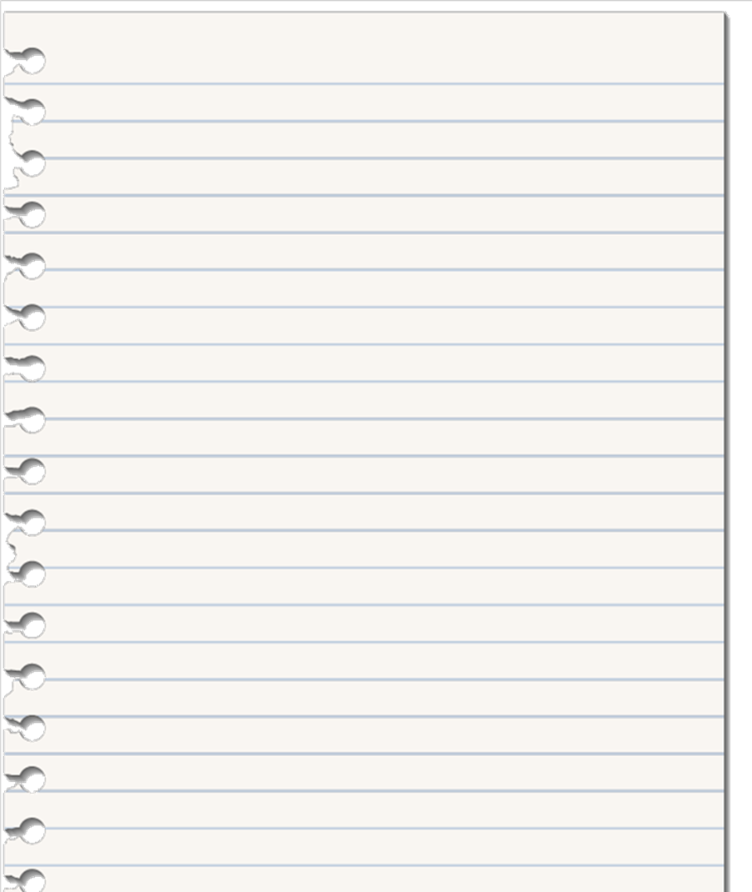
Bubble sort
We have declared a function called bubbleSort that takes in one parameter – an array of data items we want to sort, called items.
FUNCTION bubbleSort(items)
DECLARE n : INTEGER
DECLARE swapped : BOOLEAN
n ß items.Length
swapped ß True
WHILE n > 0 AND swapped DO
swapped ß False
n ß n - 1
FOR index ß 0 TO n - 1
IF items[index] > items[index+1]
THEN
Swap(items[index], items[index+1])
swapped ß true
ENDIF
NEXT index
ENDWHILE
RETURN items
ENDFUNCTION

Slide 25
Bubble sort
We declare two additional local variables to use during the bubbleSort function.
n: An integer used to keep track of how far through the items array we will need to travel on each pass through the WHILE loop.
swapped: A Boolean flag we set to true if we have just performed a swap during the sort function.
FUNCTION bubbleSort(items)
DECLARE n : INTEGER
DECLARE swapped : BOOLEAN
n ß items.Length
swapped ß True
WHILE n > 0 AND swapped DO
swapped ß False
n ß n - 1
FOR index ß 0 TO n - 1
IF items[index] > items[index+1]
THEN
Swap(items[index], items[index+1])
swapped ß true
ENDIF
NEXT index
ENDWHILE
RETURN items
ENDFUNCTION

Slide 26
Bubble sort
We now set n to the length of the items array and initialise the swapped flag to true.
FUNCTION bubbleSort(items)
DECLARE n : INTEGER
DECLARE swapped : BOOLEAN
n ß items.Length
swapped ß True
WHILE n > 0 AND swapped DO
swapped ß False
n ß n - 1
FOR index ß 0 TO n - 1
IF items[index] > items[index+1]
THEN
Swap(items[index], items[index+1])
swapped ß true
ENDIF
NEXT index
ENDWHILE
RETURN items
ENDFUNCTION

Slide 27
Bubble sort
Now we enter a WHILE loop that will run as long as n is greater than 0 and swaps are taking place.
FUNCTION bubbleSort(items)
DECLARE n : INTEGER
DECLARE swapped : BOOLEAN
n ß items.Length
swapped ß True
WHILE n > 0 AND swapped DO
swapped ß False
n ß n - 1
FOR index ß 0 TO n - 1
IF items[index] > items[index+1]
THEN
Swap(items[index], items[index+1])
swapped ß true
ENDIF
NEXT index
ENDWHILE
RETURN items
ENDFUNCTION

Slide 28
Bubble sort
Every time we start a new pass through the WHILE loop, we set the swapped flag to false.
In other words, each time through the loop, we assume a swap doesn’t need to be made until we discover otherwise.
FUNCTION bubbleSort(items)
DECLARE n : INTEGER
DECLARE swapped : BOOLEAN
n ß items.Length
swapped ß True
WHILE n > 0 AND swapped DO
swapped ß False
n ß n - 1
FOR index ß 0 TO n - 1
IF items[index] > items[index+1]
THEN
Swap(items[index], items[index+1])
swapped ß true
ENDIF
NEXT index
ENDWHILE
RETURN items
ENDFUNCTION

Slide 29
Bubble sort
The array is zero-indexed – the first item starts at position 0, not position 1 – so we decrement the number of items to check by 1.
FUNCTION bubbleSort(items)
DECLARE n : INTEGER
DECLARE swapped : BOOLEAN
n ß items.Length
swapped ß True
WHILE n > 0 AND swapped DO
swapped ß False
n ß n - 1
FOR index ß 0 TO n - 1
IF items[index] > items[index+1]
THEN
Swap(items[index], items[index+1])
swapped ß true
ENDIF
NEXT index
ENDWHILE
RETURN items
ENDFUNCTION

Slide 30
Bubble sort
Next we enter a FOR loop that will run n number of times – in other words, check every item.
FUNCTION bubbleSort(items)
DECLARE n : INTEGER
DECLARE swapped : BOOLEAN
n ß items.Length
swapped ß True
WHILE n > 0 AND swapped DO
swapped ß False
n ß n - 1
FOR index ß 0 TO n - 1
IF items[index] > items[index+1]
THEN
Swap(items[index], items[index+1])
swapped ß true
ENDIF
NEXT index
ENDWHILE
RETURN items
ENDFUNCTION

Slide 31
Bubble sort
Now we use an IF statement to check an item in the array against the item next to it.
FUNCTION bubbleSort(items)
DECLARE n : INTEGER
DECLARE swapped : BOOLEAN
n ß items.Length
swapped ß True
WHILE n > 0 AND swapped DO
swapped ß False
n ß n - 1
FOR index ß 0 TO n - 1
IF items[index] > items[index+1]
THEN
Swap(items[index], items[index+1])
swapped ß true
ENDIF
NEXT index
ENDWHILE
RETURN items
ENDFUNCTION

Slide 32
Bubble sort
If the item is greater than the one we are comparing it to, it needs to be swapped.
Here we have used a made-up function that will perform the swap for us. Instead, we could use a temporary variable to perform the swap:
temp ß items[index]
items[index] ß items[index + 1]
items[index + 1] ß temp
We also set the swapped flag to true to indicate that a swap has just taken place.
FUNCTION bubbleSort(items)
DECLARE n : INTEGER
DECLARE swapped : BOOLEAN
n ß items.Length
swapped ß True
WHILE n > 0 AND swapped DO
swapped ß False
n ß n - 1
FOR index ß 0 TO n - 1
IF items[index] > items[index+1]
THEN
Swap(items[index], items[index+1])
swapped ß true
ENDIF
NEXT index
ENDWHILE
RETURN items
ENDFUNCTION

Slide 33
Bubble sort
When the WHILE loop is exited, we know all the data in the items array must be sorted. So, the only thing left to do is return the sorted array and exit the bubbleSort function.
FUNCTION bubbleSort(items)
DECLARE n : INTEGER
DECLARE swapped : BOOLEAN
n ß items.Length
swapped ß True
WHILE n > 0 AND swapped DO
swapped ß False
n ß n - 1
FOR index ß 0 TO n - 1
IF items[index] > items[index+1]
THEN
Swap(items[index], items[index+1])
swapped ß true
ENDIF
NEXT index
ENDWHILE
RETURN items
ENDFUNCTION

Slide 34



Cambridge IGCSE pseudocode
The pseudocode in these videos follows the exact style that will be used in the exams.
The full set of pseudocode is defined in the syllabus:
Cambridge IGCSE (9-1) Computer Science – 0984
Cambridge IGCSE (A*-G) Computer Science – 0478

Slide 35


Essential algorithms and data structures

Slide 36
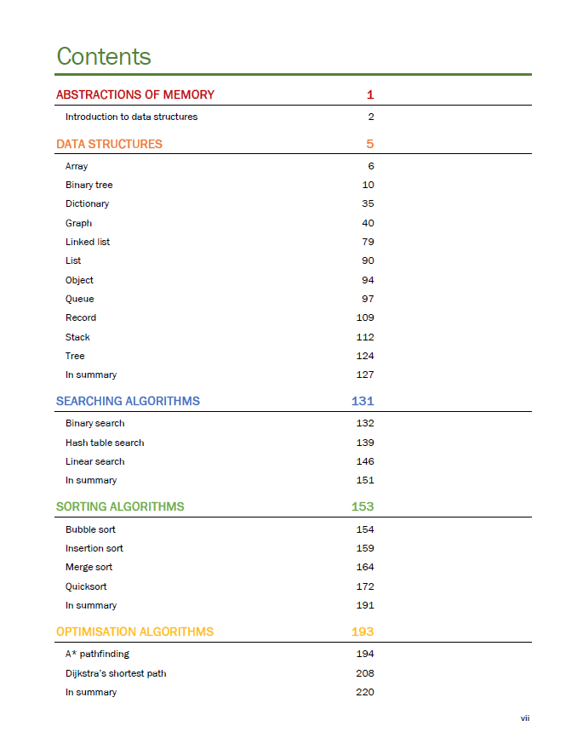
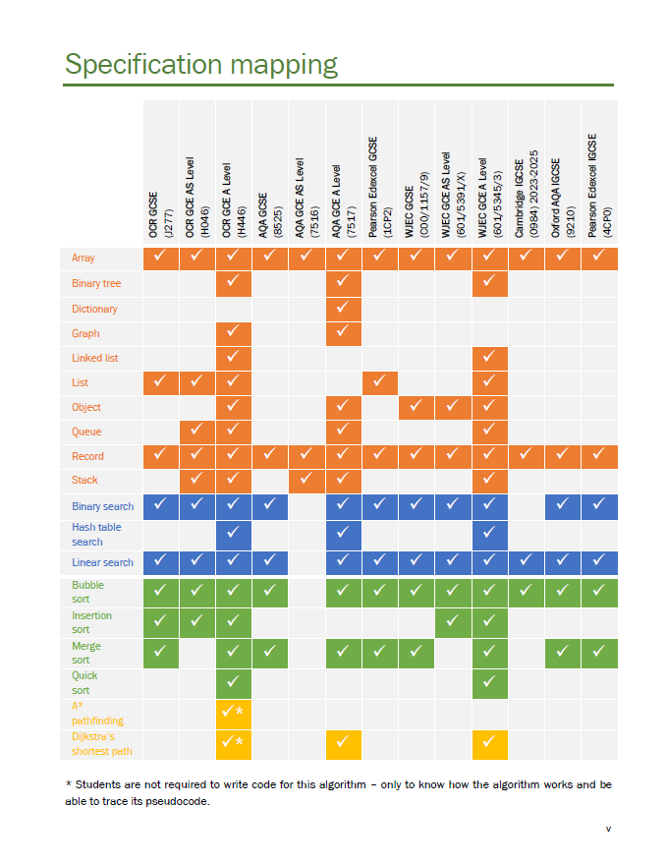

Slide 37
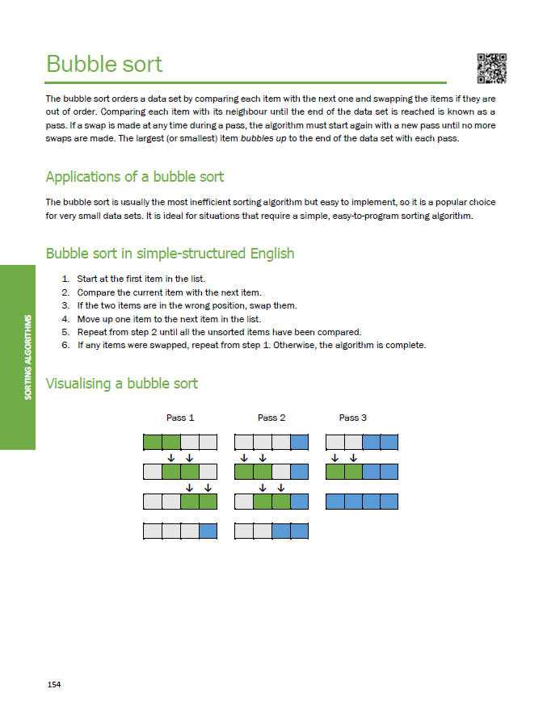
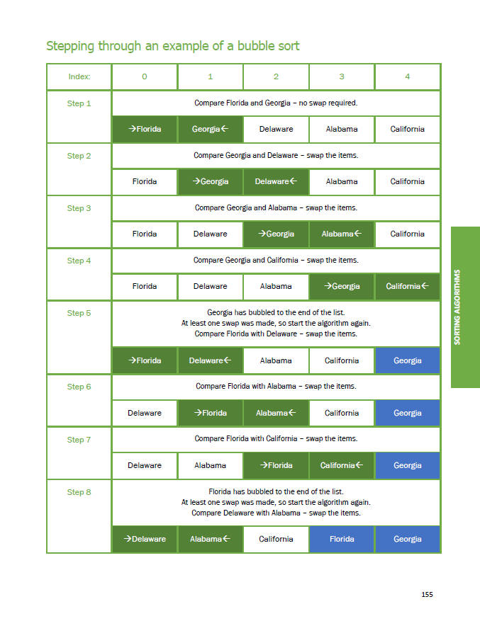

Slide 38
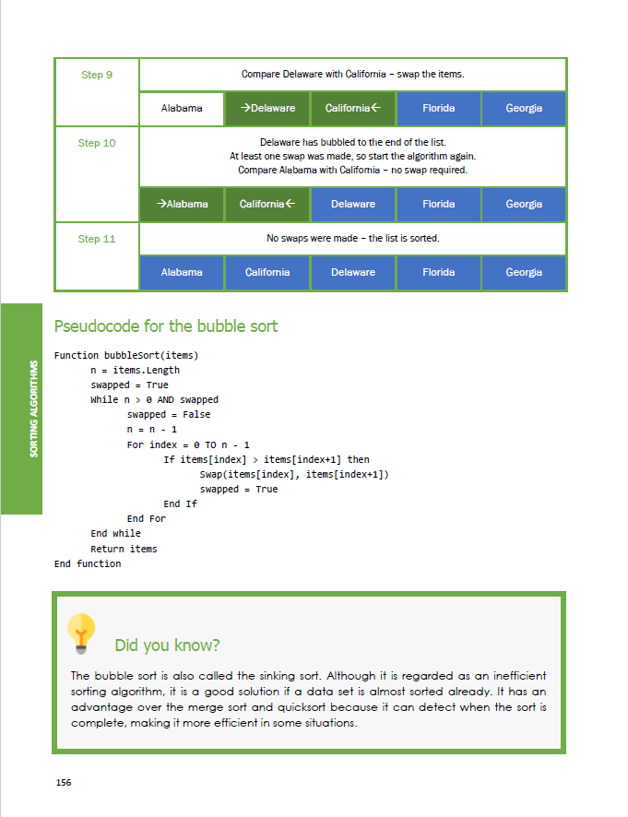
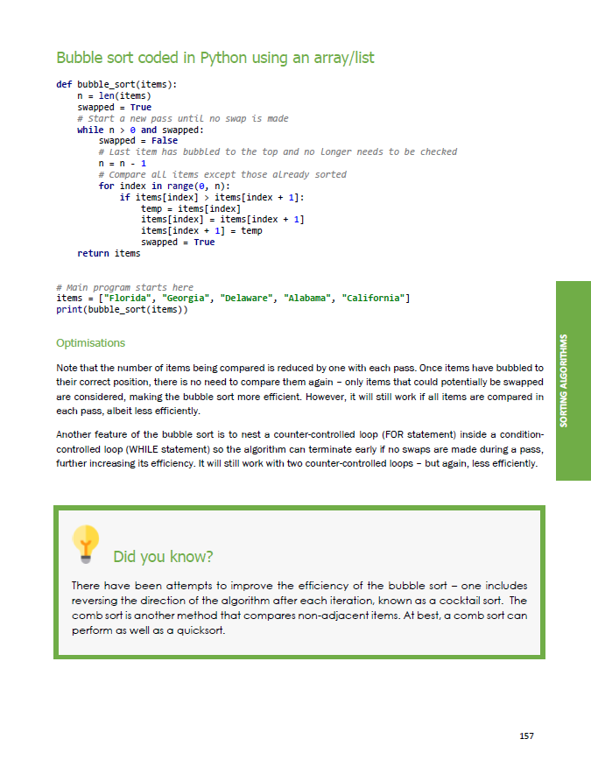

Slide 39


